Slide 1
Risk Based Part Qualification and the implications for NDT
BINDT – NDT for Metallic Airframe Components
Dr. Simon Lewis
20th April 2021

Slide 2
About Norton-Straw
Our Team
A growing team of 20 full time employees
Engineering and technology specialists with out-of-the box capability
Our Locations
Derby, UK: Headquarters in Historic Darley Abbey Mills
Bristol, UK: Historic-quarter of city centre
Hubs for UK aerospace industry
Well connected to Europe by East Midlands and Bristol Airport
Our Infrastructure
We maintain our own high-performance computing capability capable of tackling complex engineering problems without dragging on our customer’s infrastructure
We hold our own licenses for a suite of industry recognised analysis tools; notably STARCCM+, the ANSYS Workbench suite and ABAQUS

Slide 3
How to use this document
This is a template document that can be used for:
Presentations
Reports issued in the presentation format
Case studies
Be sure to edit the front page and the revision history with the document details
Issue date must spell out the month (not, for example, 01/12/2021 as ambiguous in US)
Choose title appropriate for the document. Plainer title page is more conservative
Choose your title layout, choose whether or not to include watermarks
Consider the customer, the context of the document, where it will be used.
Find-and-replace to make sure the document number in the footer gets replaced everywhere (including the slide master, so new slides get the new footer)
Change the slide layout by right-clicking on it in the left navigation, choose ‘layout’

Slide 4
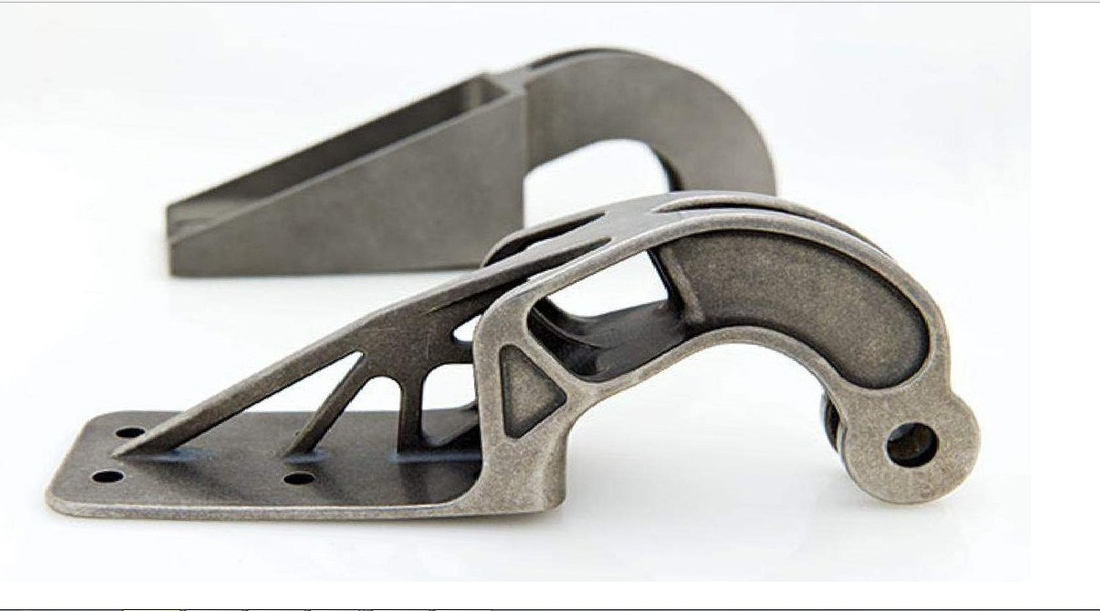
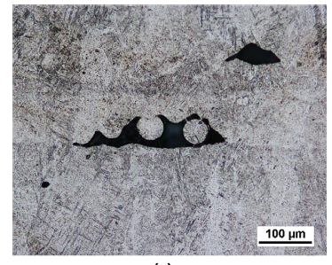
The Role of NDT and Analsysis in Certification
Max allowable defect size
Target life
Safe Life
1. Analysis:
Justify acceptance of defects where possible
Defect size
2. Inspection:
Screen out defects where analysis fails

Slide 5
The Role of NDT and Analysis in Certification
Push / Pull between inspection and analysis is necessary
Analysis results set desirable inspection requirements
What are detection size limits?
Practicalities of inspection define analysis targets
How much conservatism can be accommodated in the analysis?
Analysis Effort / Cost
Increasing Certification Life
Inspection Effort / Cost
How do we achieve the desired certified life at minimum cost / effort?

Slide 6
Certification via Defect Tolerance
Stress Analysis
characteristic stress, temperature etc. from FEA
Identify limiting location
Postulate initial crack
Life to failure
Initial Crack size, a
Life to Fracture
Fracture mechanics calculations
Critical crack size
Inspection Cost
Crack length
Number of Cycles
Life to failure
Detectable Crack size
Analysis defines a critical defect size.
Inspection is used to ensure no defects above this size enter service

Slide 7
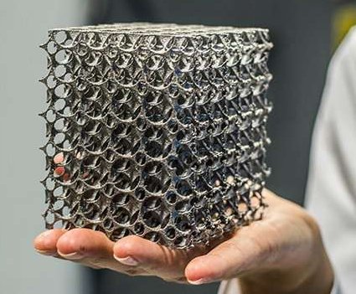
Where this falls down…
This approach has proved challenging in certifying AM (and other powder metallurgy) parts
Volumetric defects are a concern
AM part geometries are often hard to inspect
AM parts prohibitively expensive to certify for high safety duty
Inspection
cost
M. Gorelik International Journal of Fatigue 94 (2017) 168–177

Slide 8
Existing Deterministic Approach
Analysis assumes the largest defect at the worst location
Output is deterministic – part is either okay or not (Risk is 1 or 0)
This does not reflect reality!
Many components won’t have problematic sized defects
Where there are defects, they may be in positions where they will never present an integrity issue.
If we know something about the likelihood of defects occurring, we can use this information:
More refined estimate of failure risk
how it evolves over part lifetime
Probabilistic (or risk based) approach to defect tolerance widely used in Aero Engines, and is the subject of wide investigation for AM parts.
PDF_{occurance}
Initial defect size

Slide 9
Probabilistic / Risk Based Assessment Route
Stress Analysis
Knowledge of defect distribution
Stable crack growth
P_{occurance}
Repeat for a range of defect sizes and sample volumes. Whole component risk can then be estimated, e.g. from weakest link model
Split part into sample volumes
Initial defect size
$$P_{f, component}= \prod_{i=1}^{N}{P_{f,i}}$$
characteristic stress, temperature etc. from FEA
Failure risk vs life for sub volume
P_{f} =1
Fracture mechanics calculations
Probability of Failure
P_{failure}
Operating Cycles
N_{cycles}
Life to Fracture
Repeat for many defect sizes
Crack length
Crack length
Number of Cycles
Cycles to failure

Slide 10
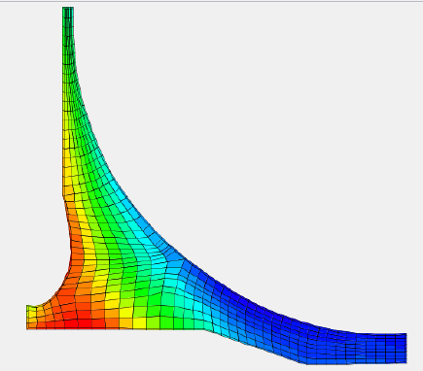
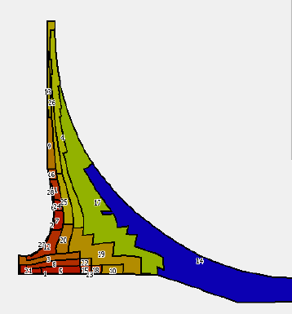
Benefits of Risk Based approach
Stress Data
We can use the results to better target inspection
Focus on areas where the impact on part risk is most significant
Avoid inspection effort where the payback on risk is low
Analysis can be used to determine the value of various inspection strategies, using POD curves
Zoned Risk Plot
Without Inspection
Increased life
Intensive inspection
P_{failure}
Inspection
cost
Expected number / unit volume
Crude inspection
Failure risk
Initial defect size
Operating Life / Cycles

Slide 11
What does this mean for NDT and Inspection?
A siloed approach to Analysis and inspection will limit the overall benefit
Design of the Analysis and Inspection strategies must be collaborative
Component risk map
Defect sizes/locations of interest
Update inspection strategy
Analysis
Critical crack size
Inspection
Update region defect probability curves
Inspection plan
Location / Region POD curves

Slide 12
Summary
Risk based defect tolerance is likely to become increasingly critical for part certification, particularly with the growth of AM components
To make full use of the benefits, much closer engagement will be needed between Analysts, Designers and NDT practitioners
Design/Analysis will need to be conducted with the inspection method, POD curves etc. in mind.

